Slide 1
Appendix C
Radiation Modeling
Introduction to CFX

Slide 2
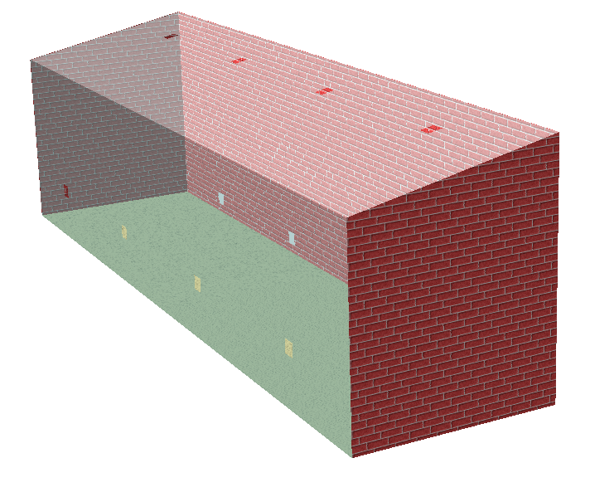
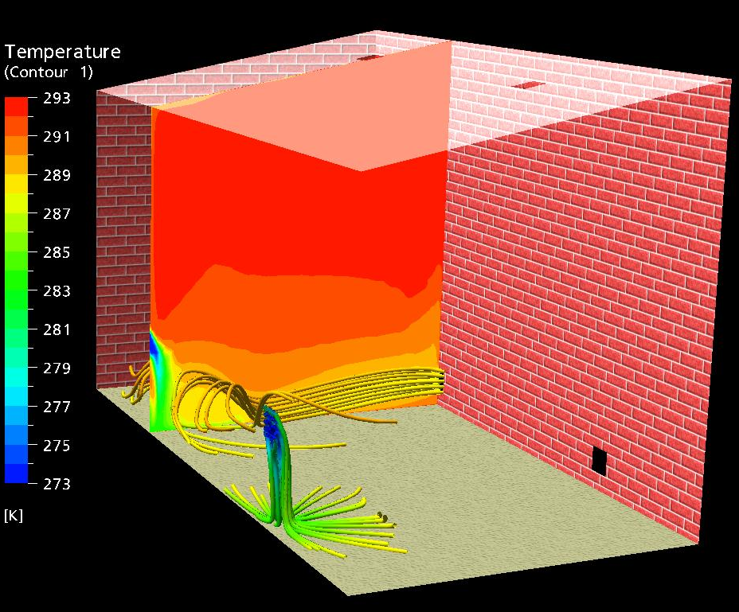
Radiation
Thermal radiation is electromagnetic radiation which arises as a result of a temperature difference between the surface of an object and its surrounding
Atrium Example

Slide 3

Radiative Transport Equation
The Radiative Transport Equation (RTE)
  Describes the propagation of radiative energy through a media which is itself emitting radiation, absorbing radiation and scattering radiation.
integro-differential equation
(very computationally expensive to solve)
Notes:
This is a very difficult equation to solve in the general case and is extremely expensive computationally.
Approximate solutions solve the problem in the optically thin/thick limit (without scattering). Examples include view factors, diffusion approximation and zonal method.

Slide 4
Radiation Models
Several radiation models are available which provide approximate solutions to the RTE
Each radiation model has its assumptions, limitations, and benefits
  1) Rosseland Model (Diffusion Approximation Model)
  2) P-1 Model (Gibb’s Model/Spherical Harmonics Model)
  3) Discrete Transfer Model (Shah Model)
  4) Monte Carlo Model (not available with the ANSYS CFD-Flo product)

Slide 5
Rosseland Model
The Rosseland Model
  Method:
    A new diffusion term is added to the energy equation
  Limitations:
    Only valid for optically thick and linearly anisotropic material (thickness/depth greater than 10)
    Not valid near walls
  Benefits:
    Does not require any boundary conditions since surfaces are treated as black (Emissivity = 1.0)
  Examples:
    Heat transfer through hot glass
    Heat transfer through semitransparent material

Slide 6
P-1 Model
The P-1 Model
  Assumptions:
    Radiation intensity is isotropic or direction independent at a given location in space
  Method:
    An additional transport equation is solved
  Limitations:
    Only valid for optical thickness/depth greater than 1.
    Not valid for transparent walls
    Needs boundary conditions on all external surfaces
  Benefits:
    Valid for non-black surfaces, non-constant properties, anisotropic scattering, and near walls
    Example: pulverized fuel flames (in regions away from the immediate vicinity of the flame)

Slide 7

Discrete Transfer Model
The Discrete Transfer Model
  Assumptions:
    Scattering is isotropic
    system is reasonably homogeneous
  Method:
    Photon paths from the bounding surfaces are determined at the beginning of the run
    Using a simplified RTE (isotropic scattering assumption) the intensity is solved along the rays
    Assuming a reasonably homogeneous system, the solution is extended to the entire domain where absorption, emission, and scattering can be solved

Slide 8
Discrete Transfer Model
The Discrete Transfer Model
  Limitations:
    lack of error information
    can suffer from the ray effects
  Benefits:
    Non-gray models are dealt with by treating each band as a separate calculation
    Better quality solution than P1 and Rosseland Models, especially when there are optically thin regions in the domain
  Example:
    Furnace Combustion

Slide 9
Monte Carlo Model
The Monte Carlo Model
  Assumptions:
    Intensity is proportional to the differential angular flux of photons and radiation field treated as a photon gas
      i.e. For grey analysis, # of histories α T⁴
  Method:
    By following a typical selection of photons and tallying (in each volume element):
      The distance traveled
      → the mean total intensity
      The distance times the absorption coefficient
        → the mean total absorbed intensity
      3. The distance times the scattering coefficient
        → the mean total scattered intensity

Slide 10
Monte Carlo Model
The Monte Carlo Model
  Limitations:
    Computationally intensive: Samples and ray traces the domain every solution step.
    always contains statistical error ≈ 1/√N
  Benefits:
    Very general purpose method - allows you to do gray/non-gray, scattering, emission and absorption
    It is the recommended choice for a transparent media radiation calculation

